Slide 1


River Falls Hydroelectric Project (FERC P-10489) Powell Falls Dam Safety Inspection and Repair or Management Options January 19, 2020

Slide 2
Introductions
Pete Haug, PE
Senior Project Manager
Ayres
E: haugp@ayresassociates.com

Slide 3
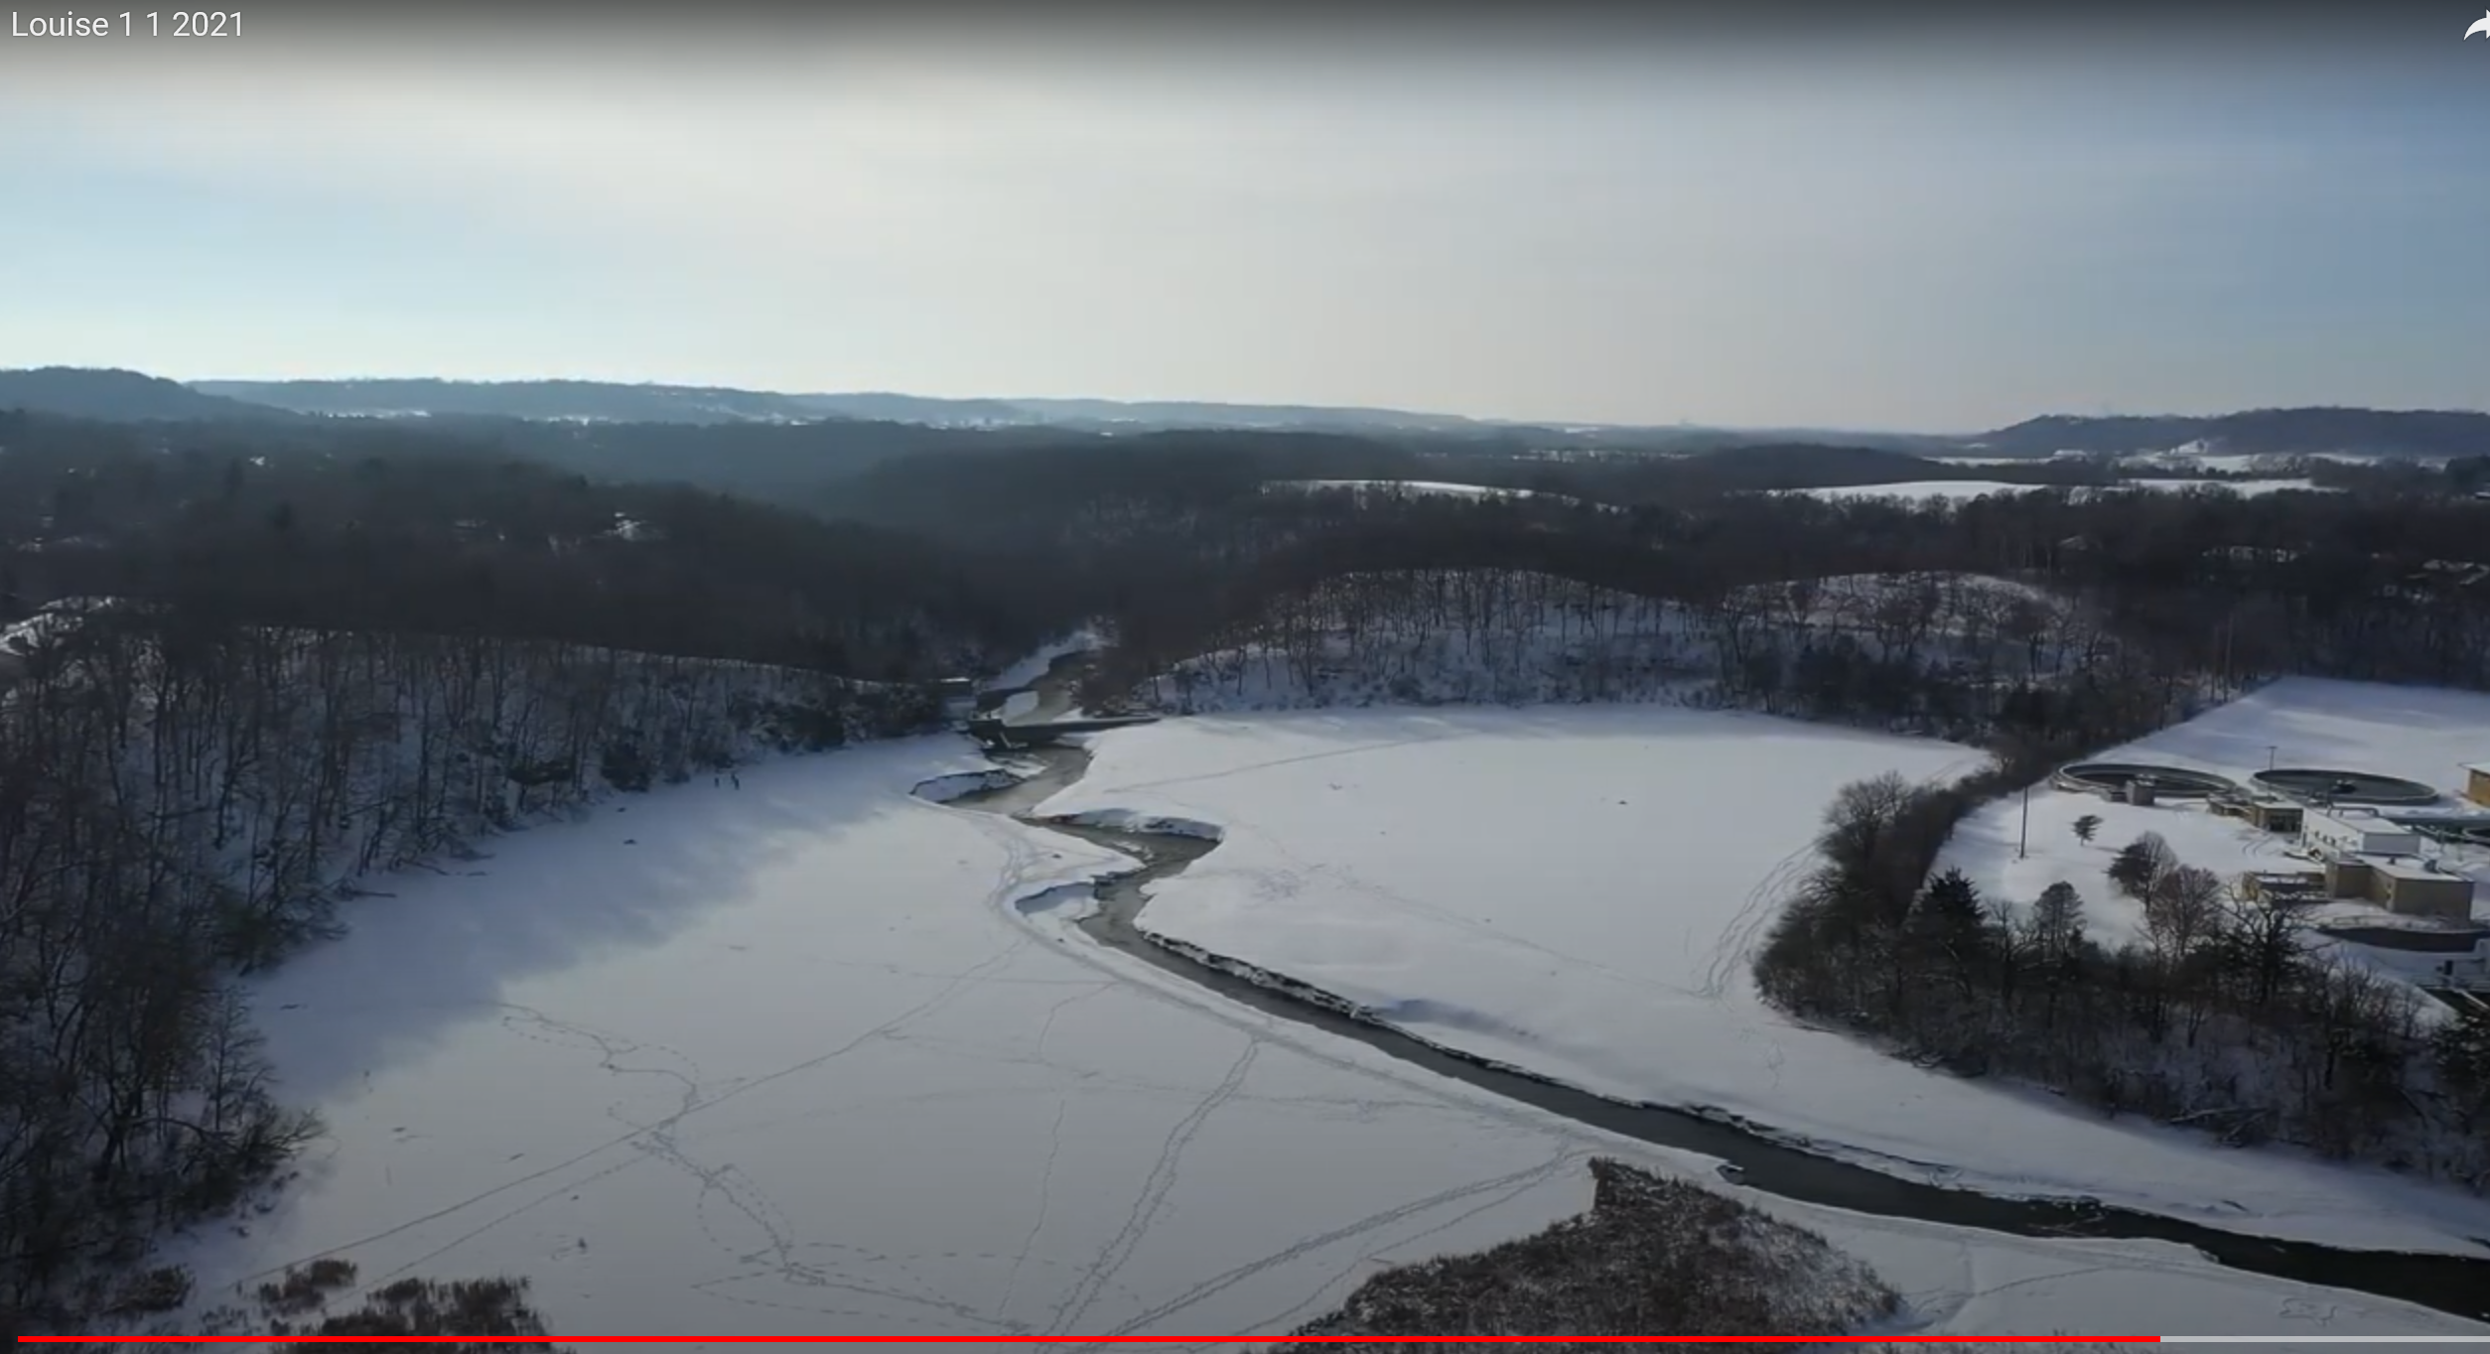
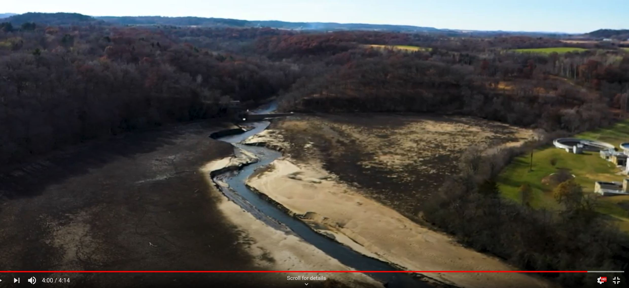
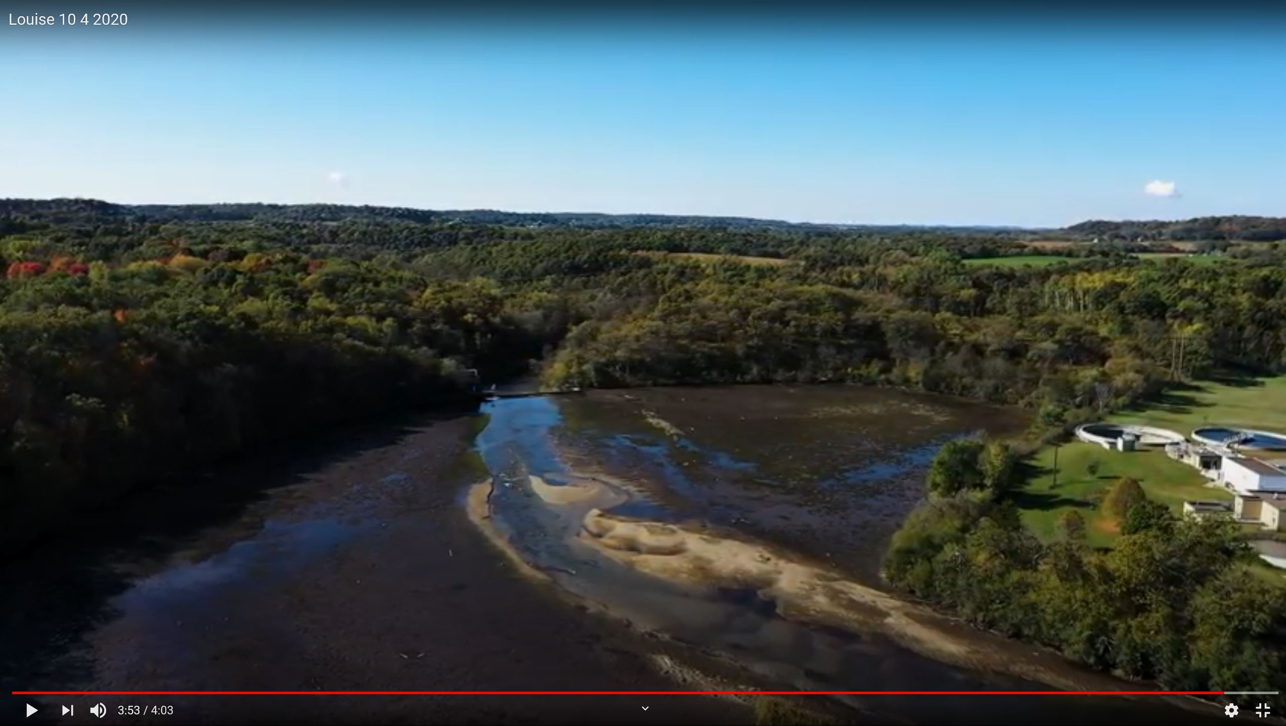
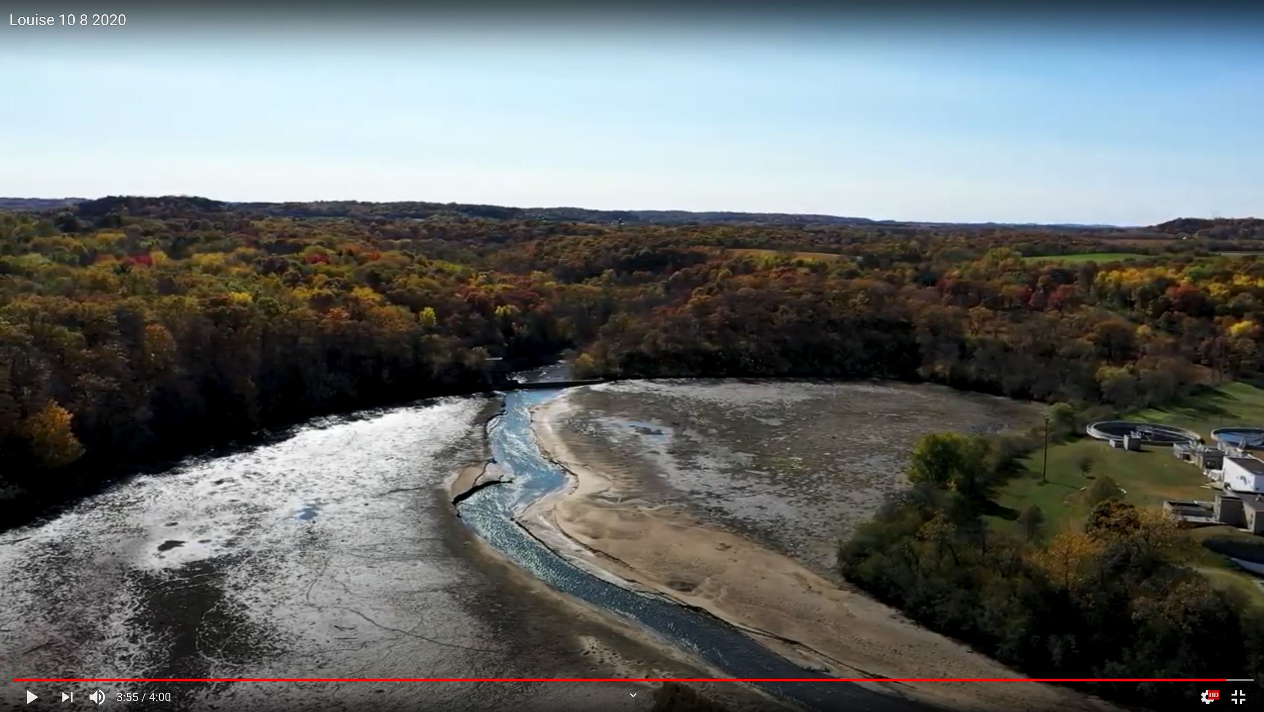
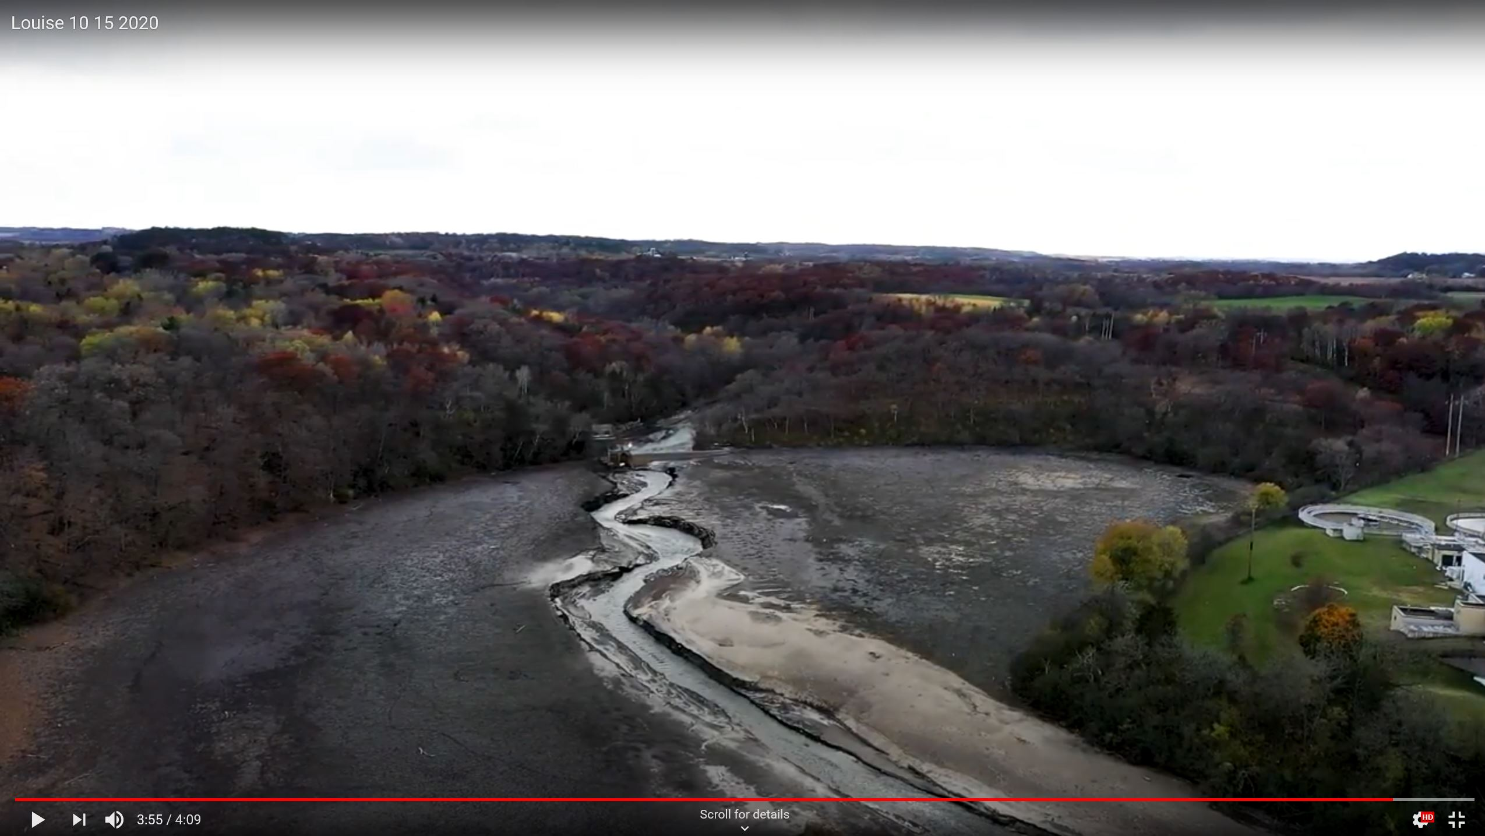
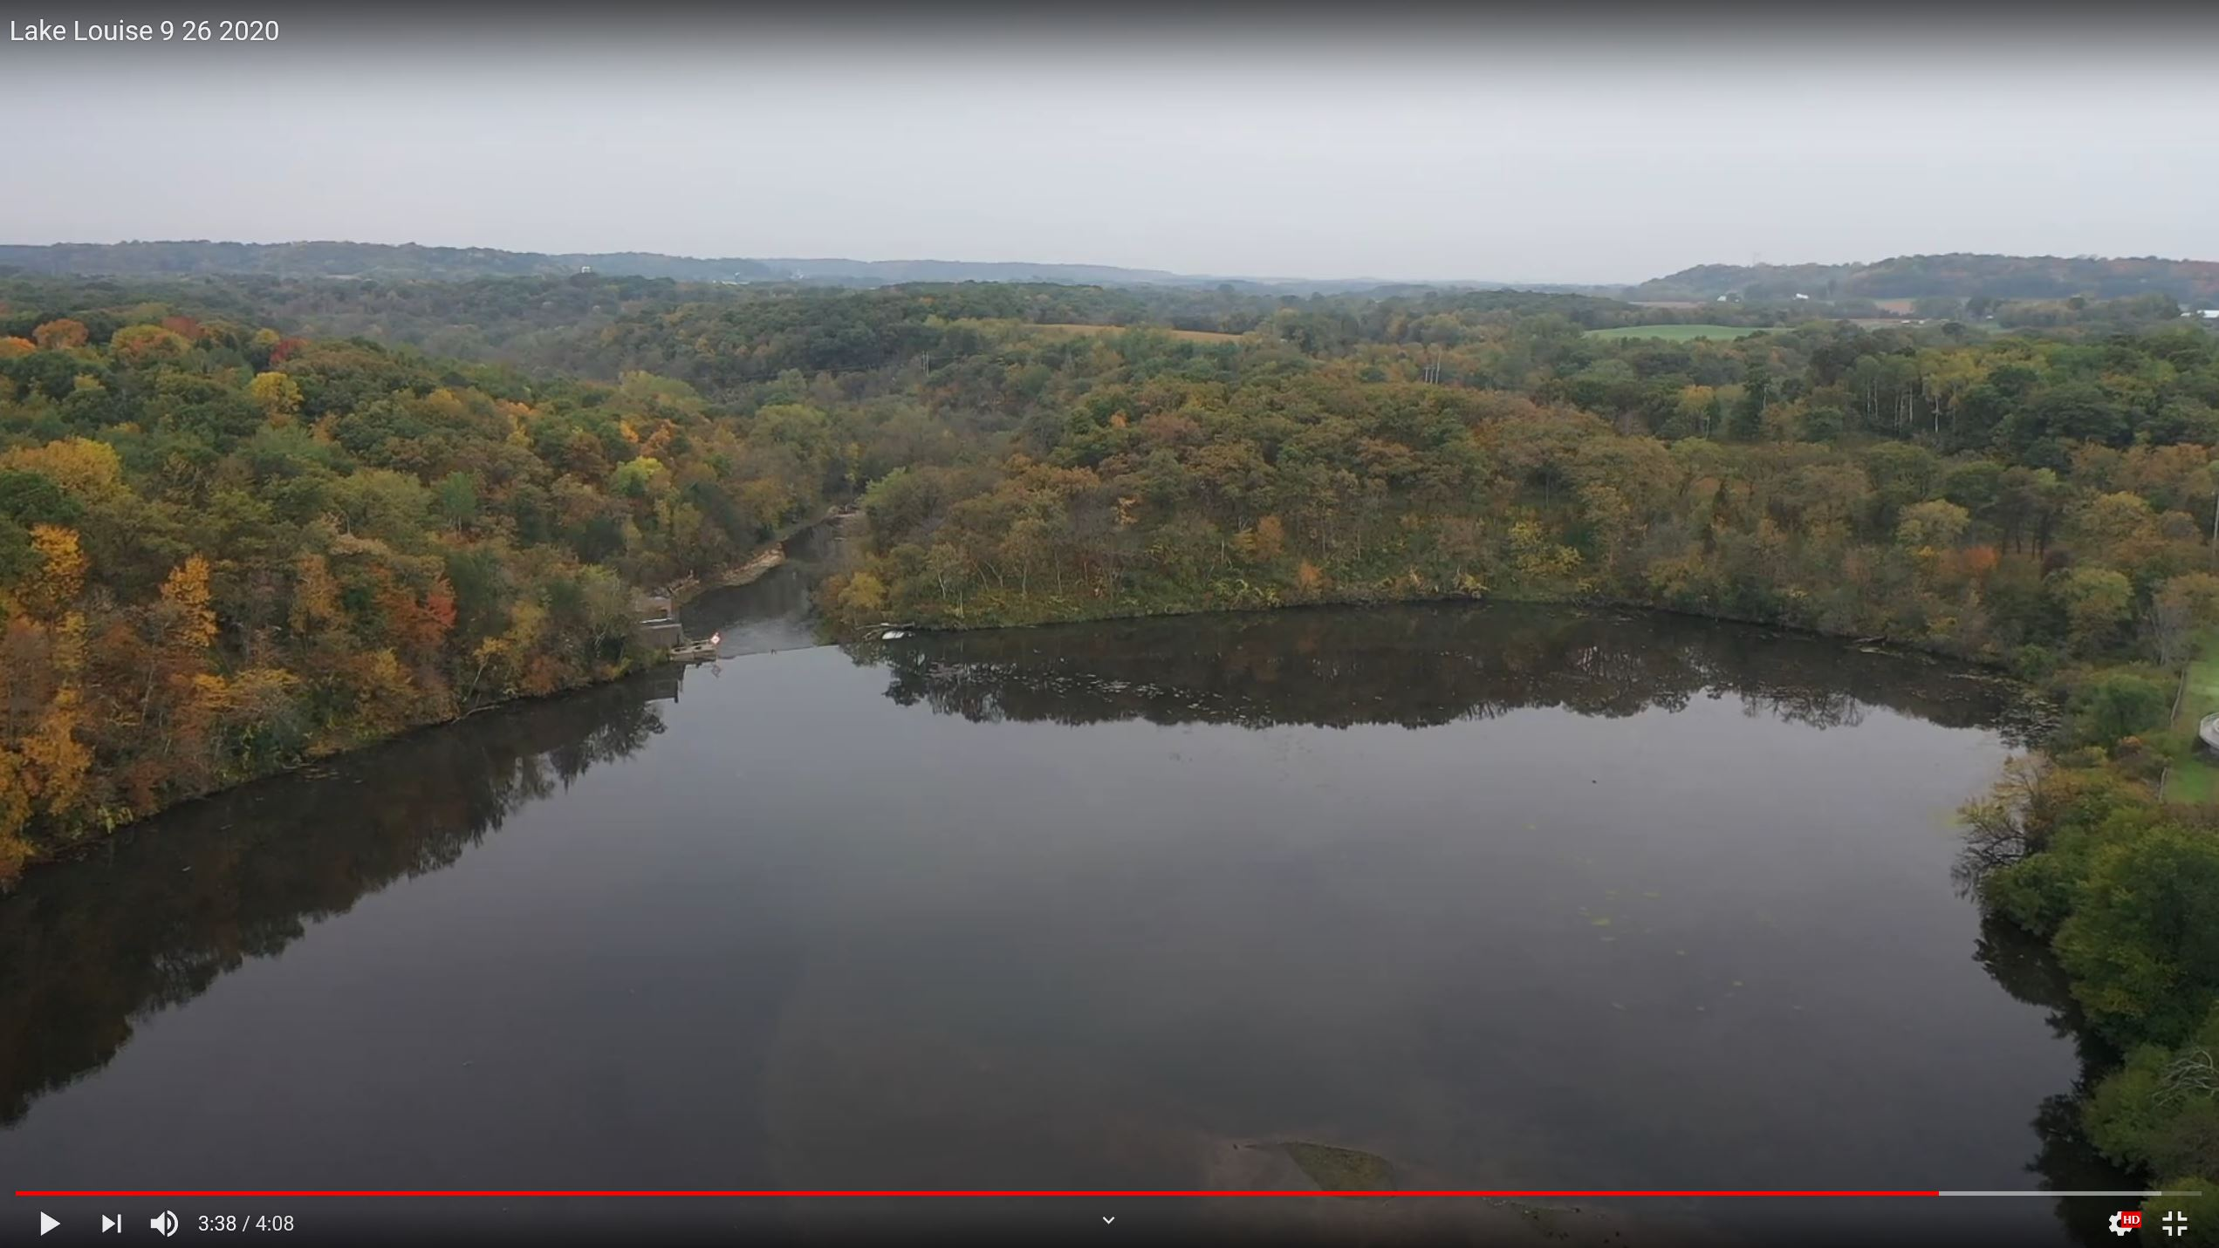
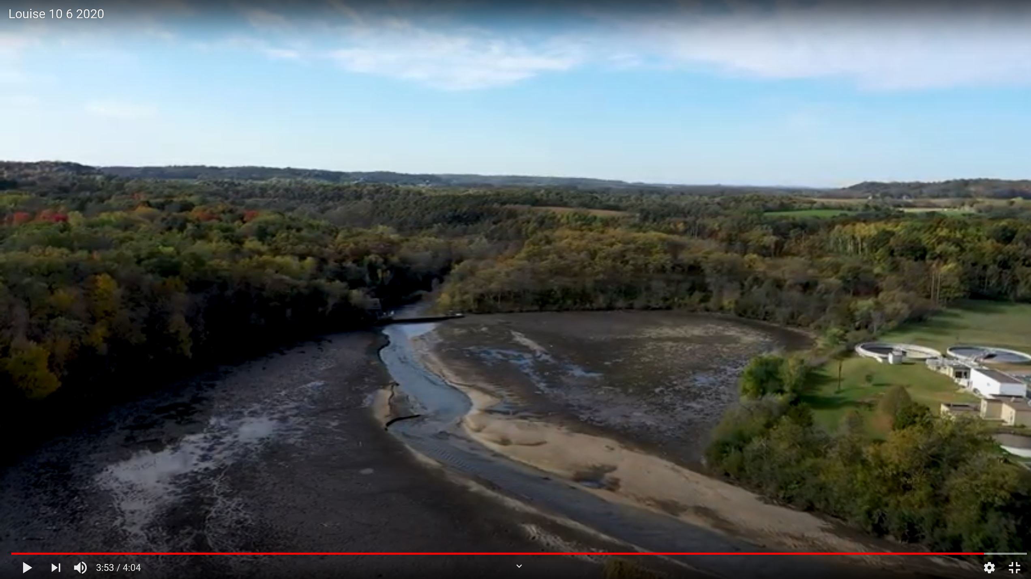
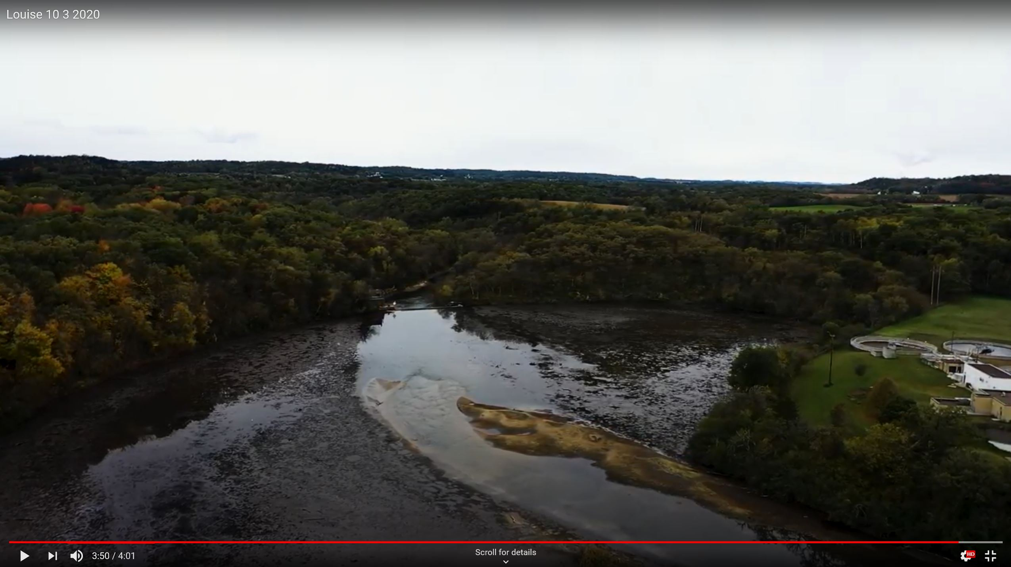
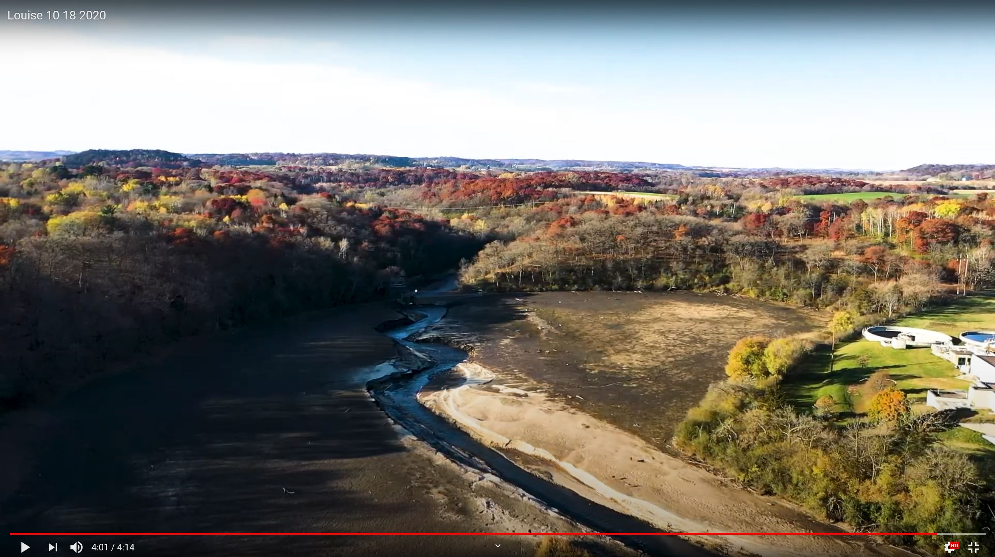
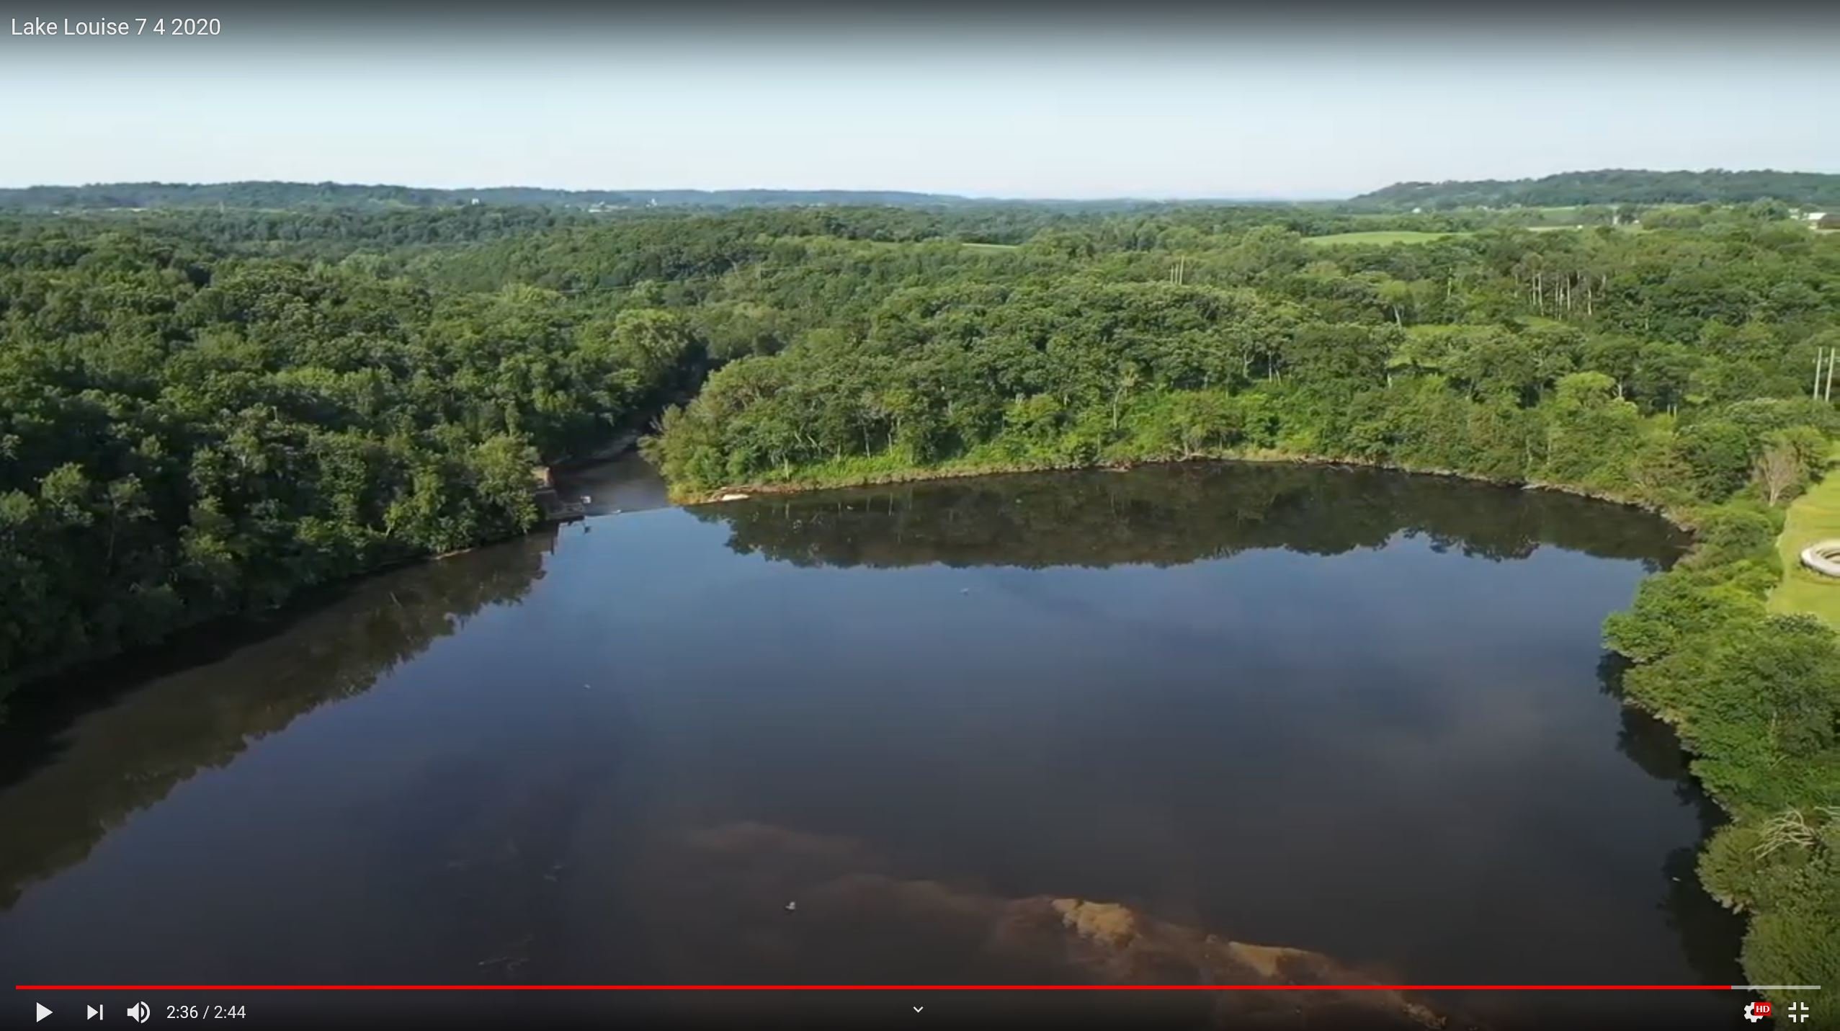
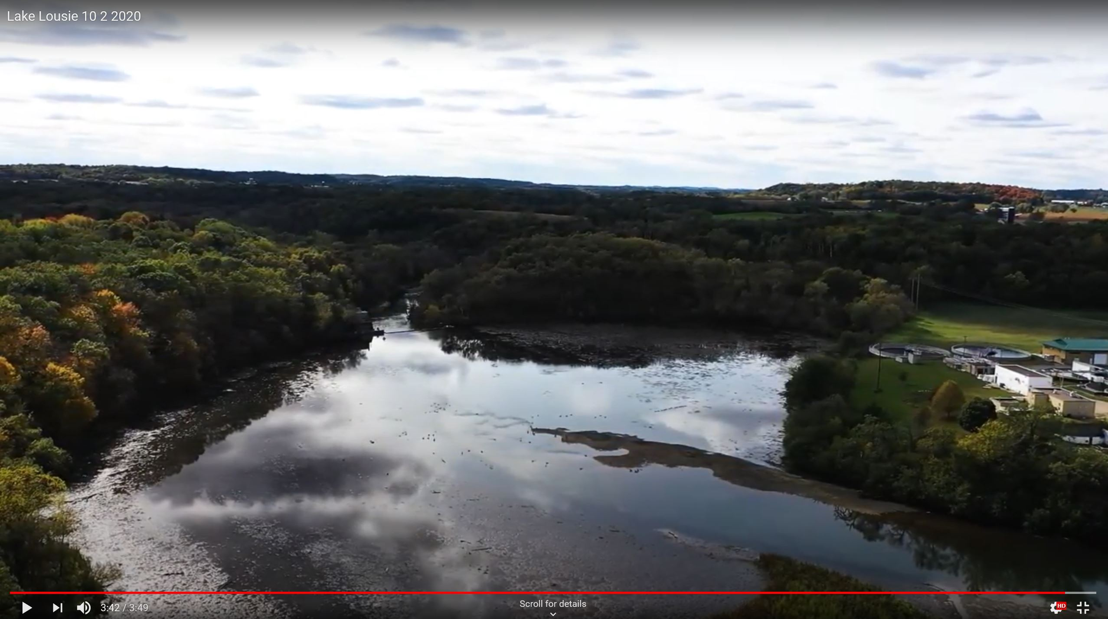
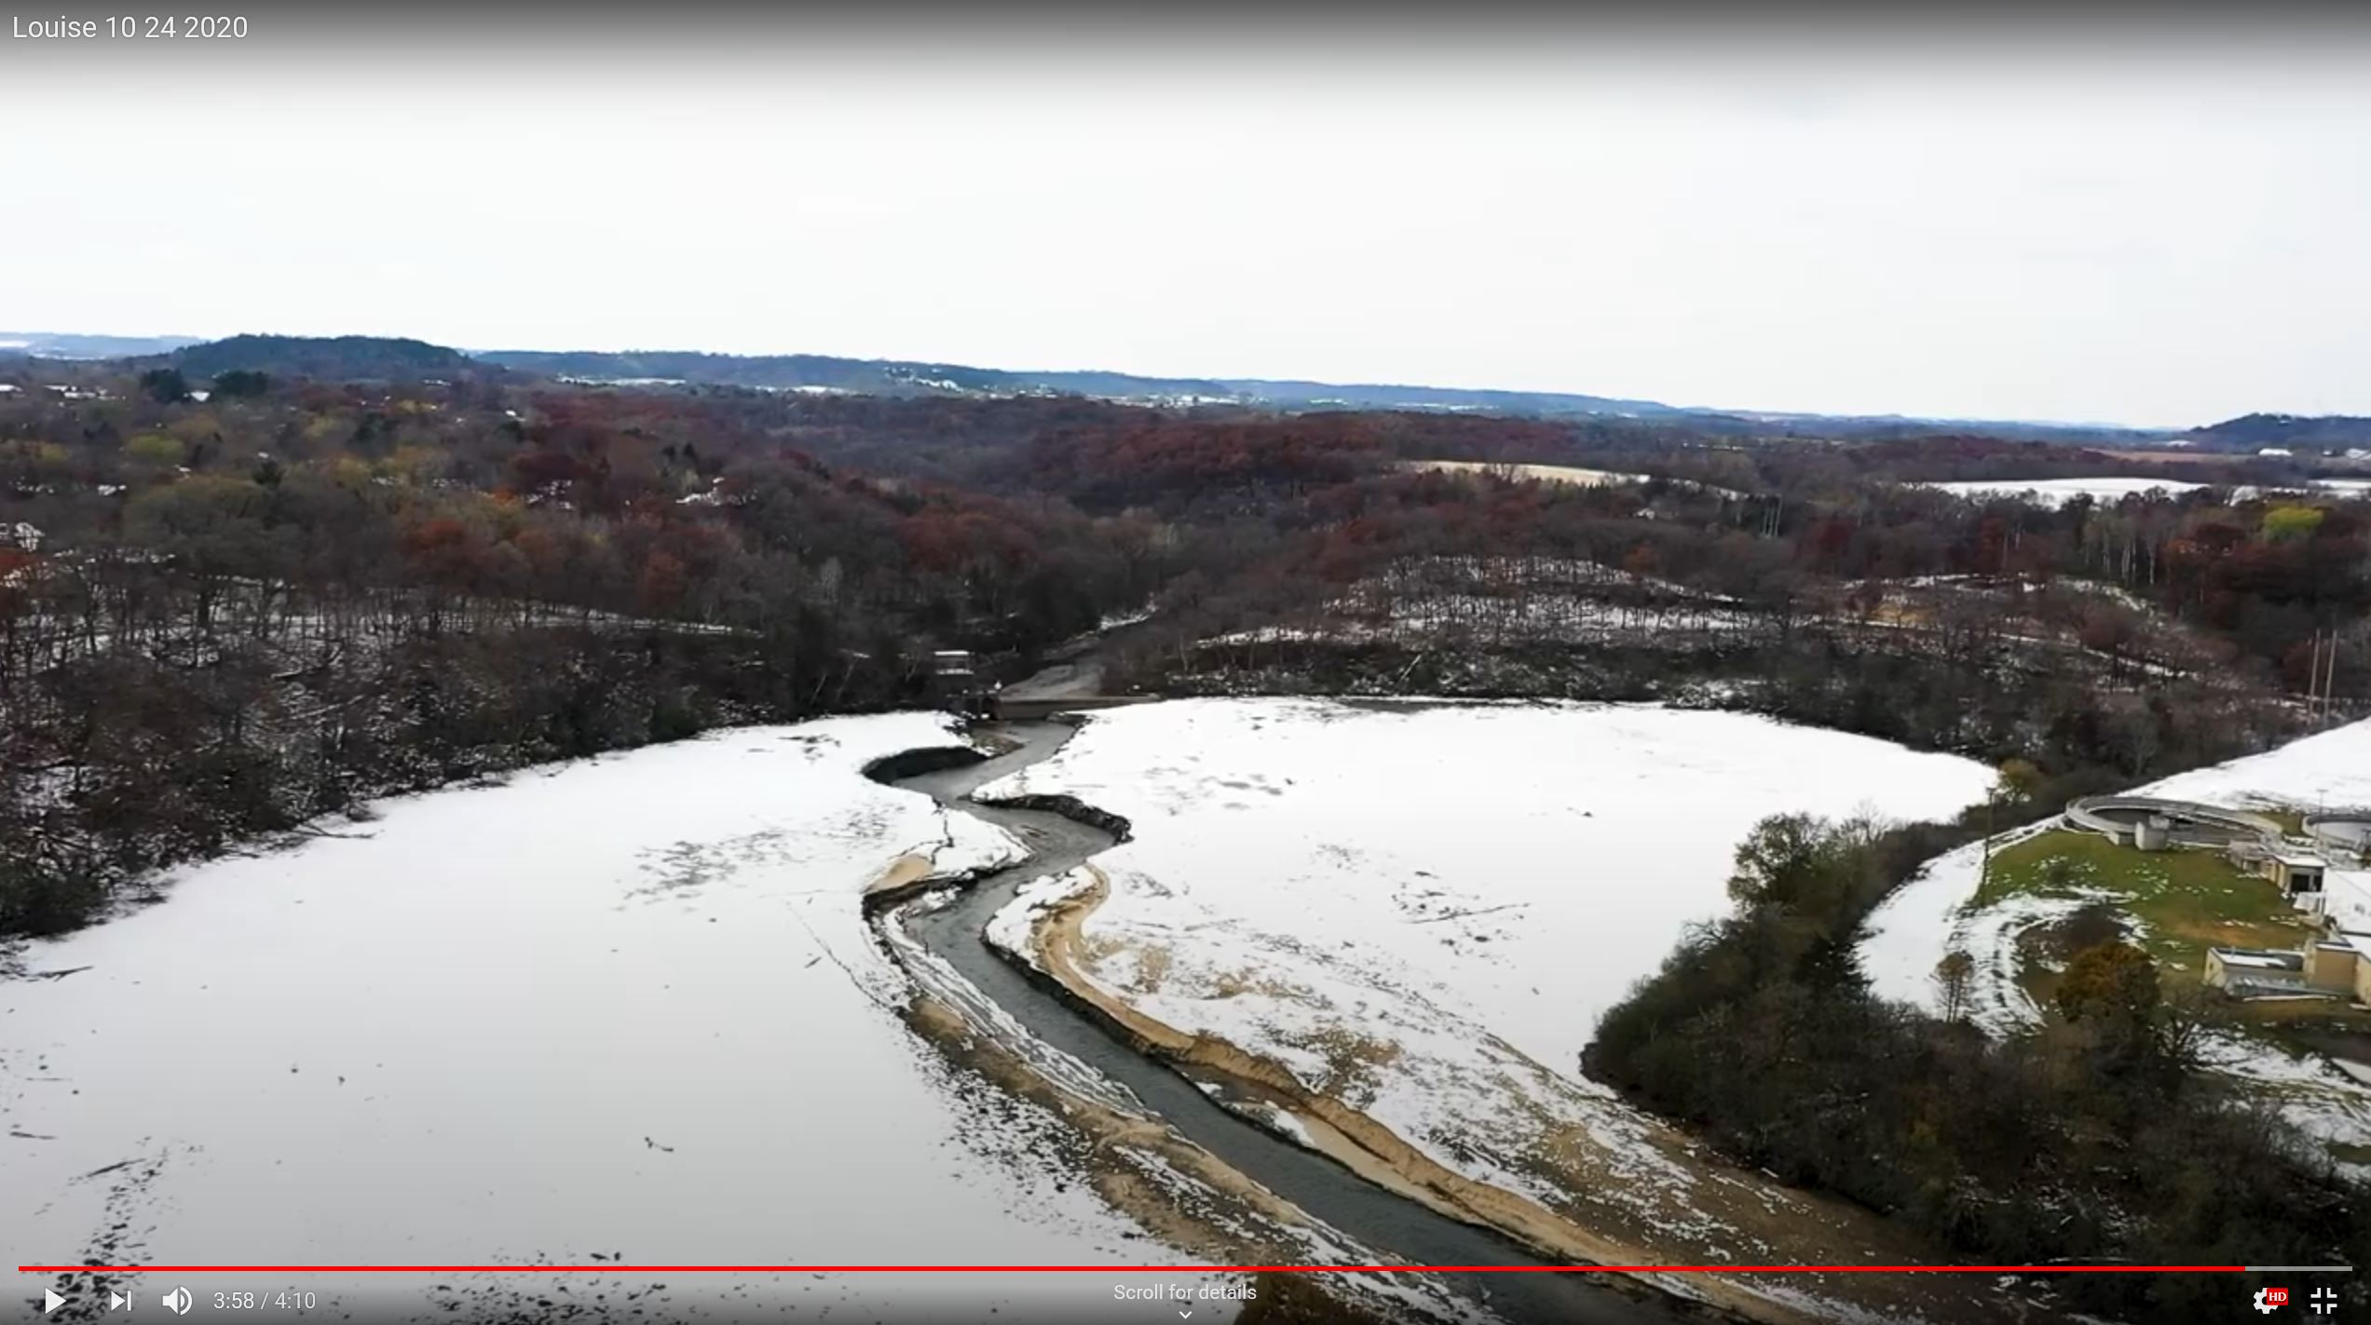
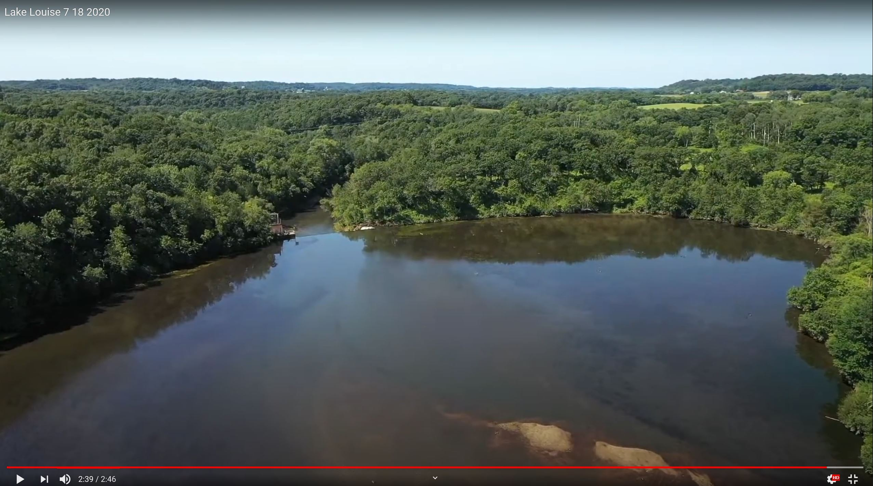
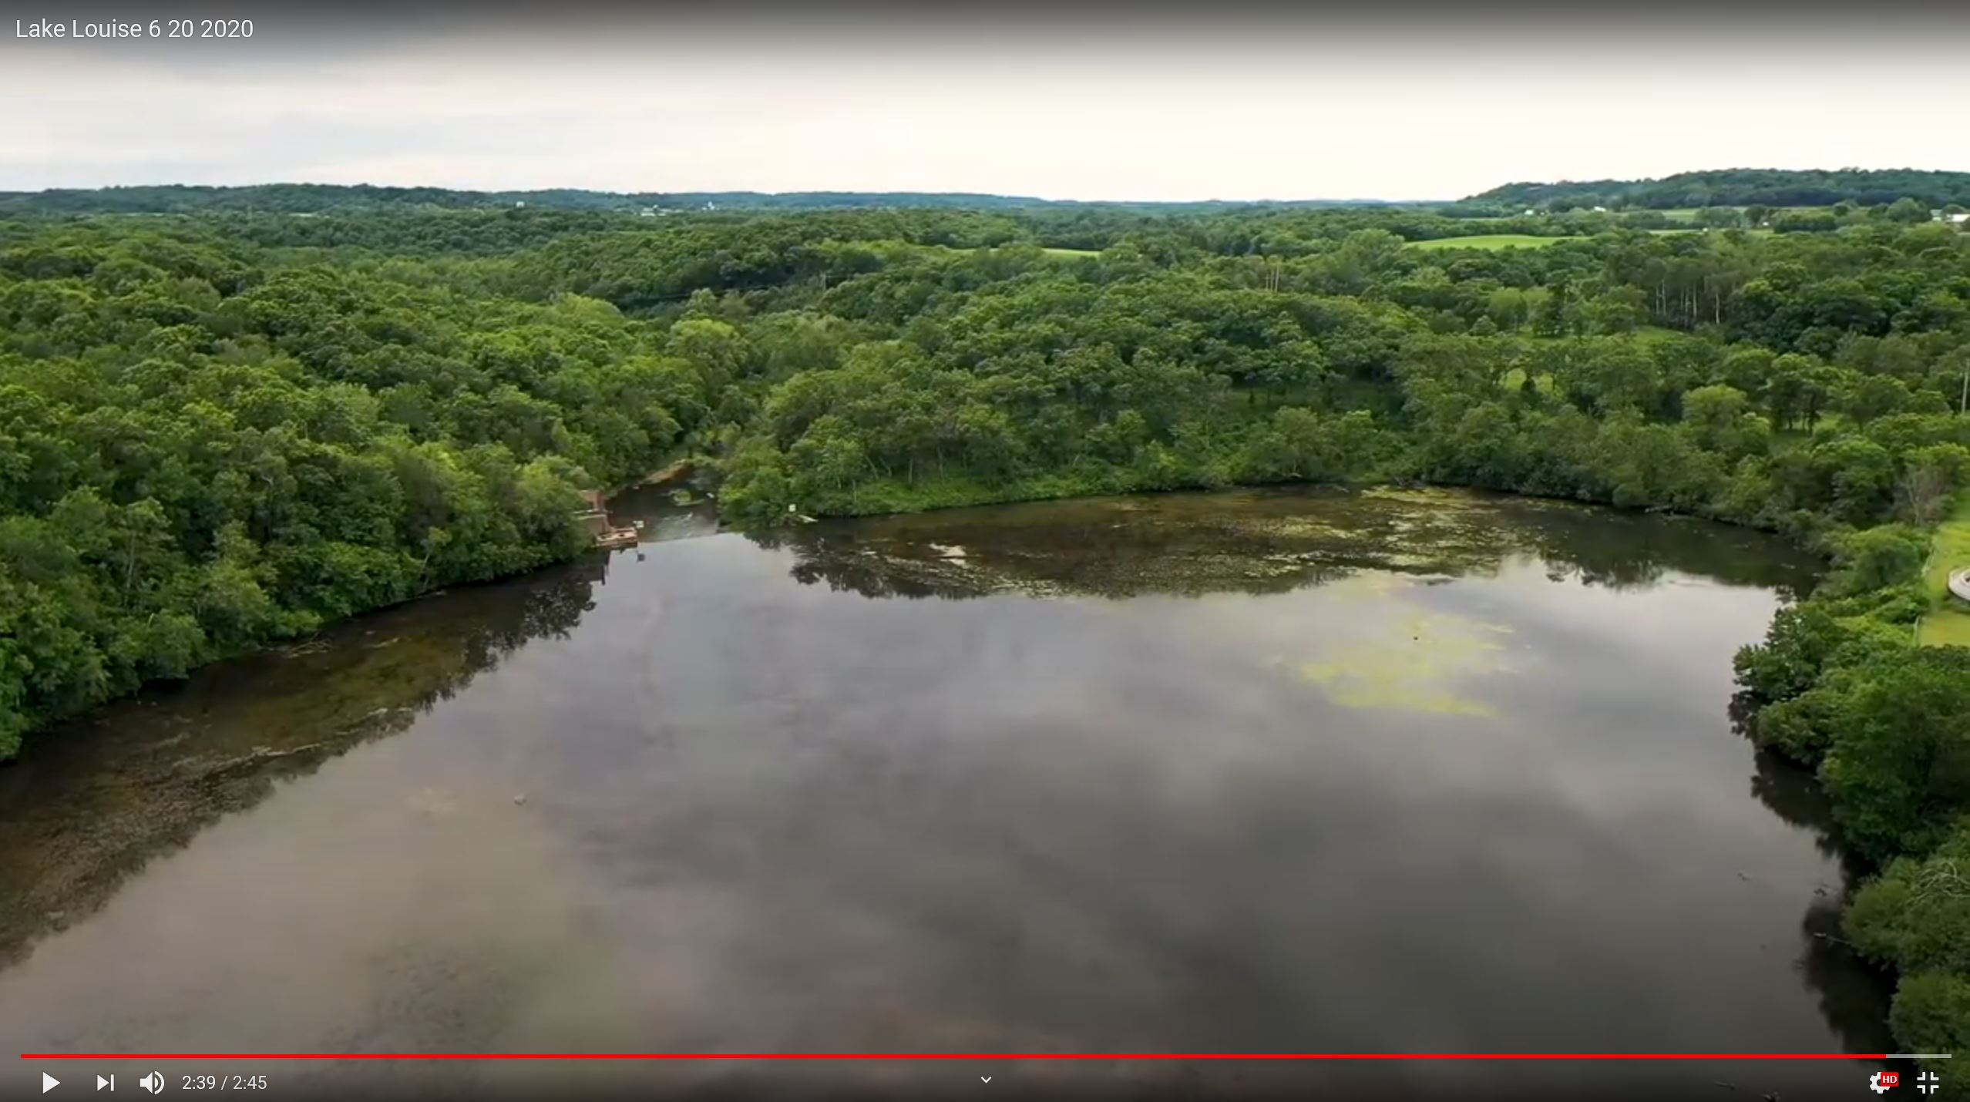
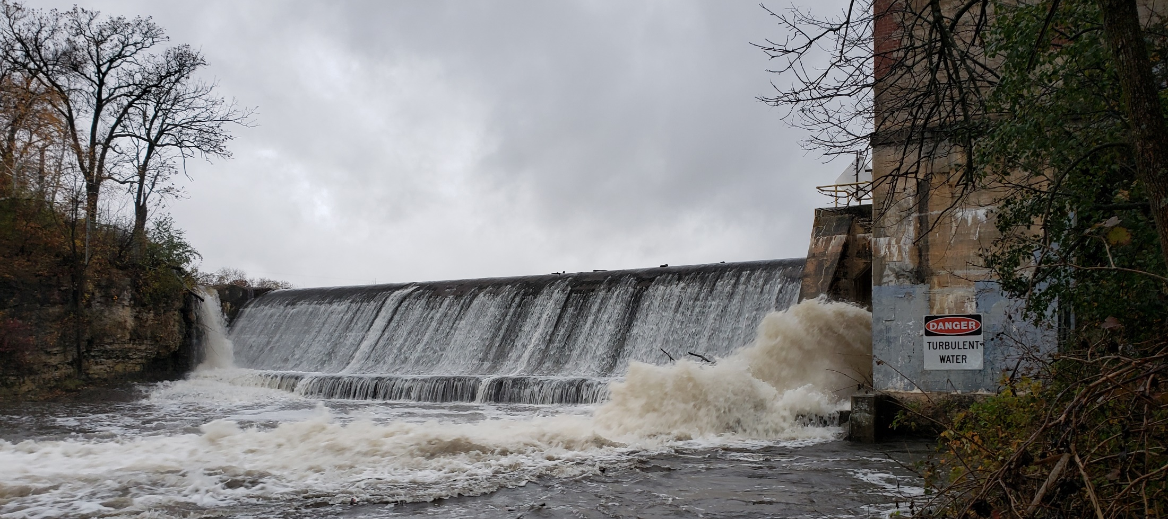
Kinni Corridor Committee graciously provided regular drone footage from River Sky Drones.
Images below are from https://www.youtube.com/channel/UCB-jCo-8r4iQVowaFzC1UhQ/videos

Slide 4
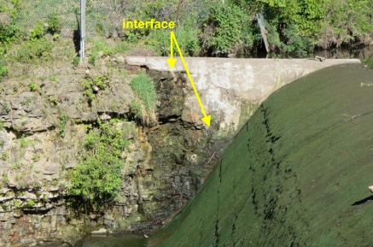
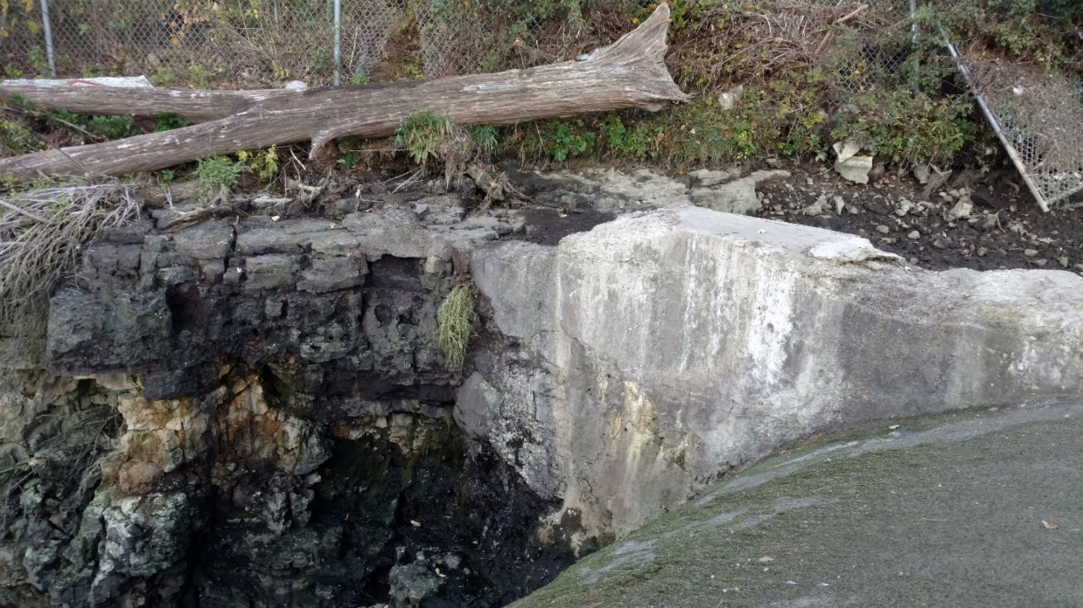
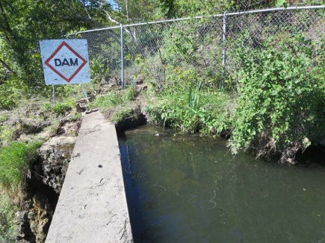
October Dam Inspection
1. Concern – right abutment concrete loss, highly fractured bedrock, loss of ability to keep winter pool high enough to prevent ice formation on post-tensioned spillway concrete.
2015
2015
2020

Slide 5
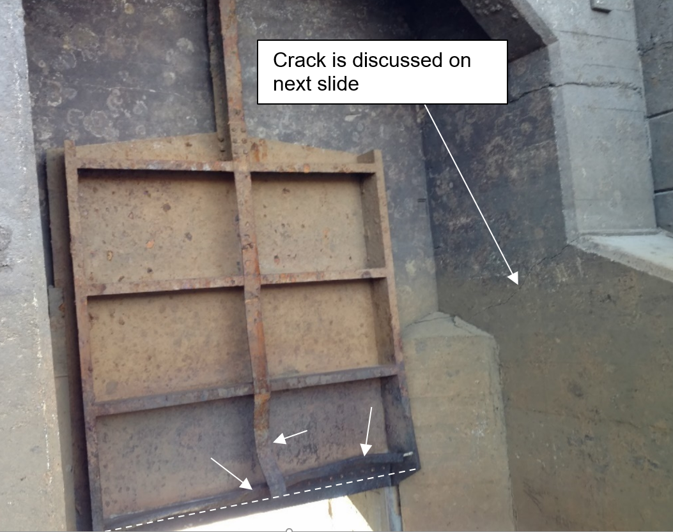
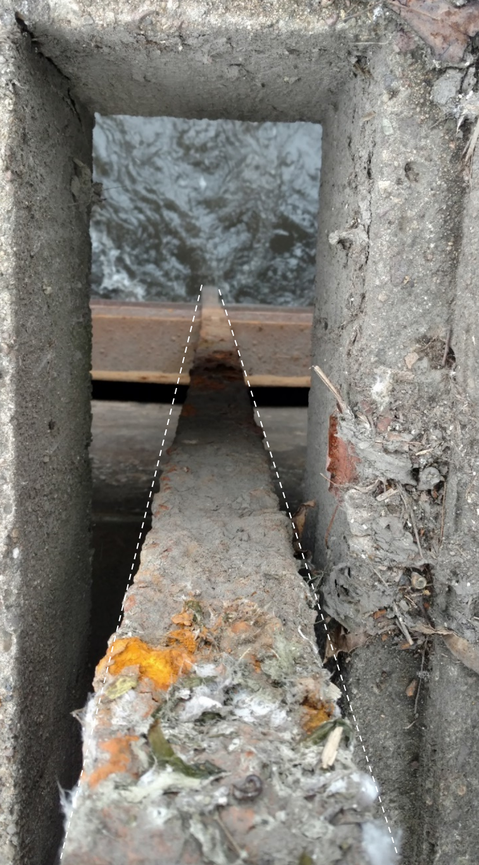
October Dam Inspection
2. Concern – bent gate hoist stem, bent gate strut, and bent structural strap. Difficult operability.
Looking downstream Looking downward

Slide 6
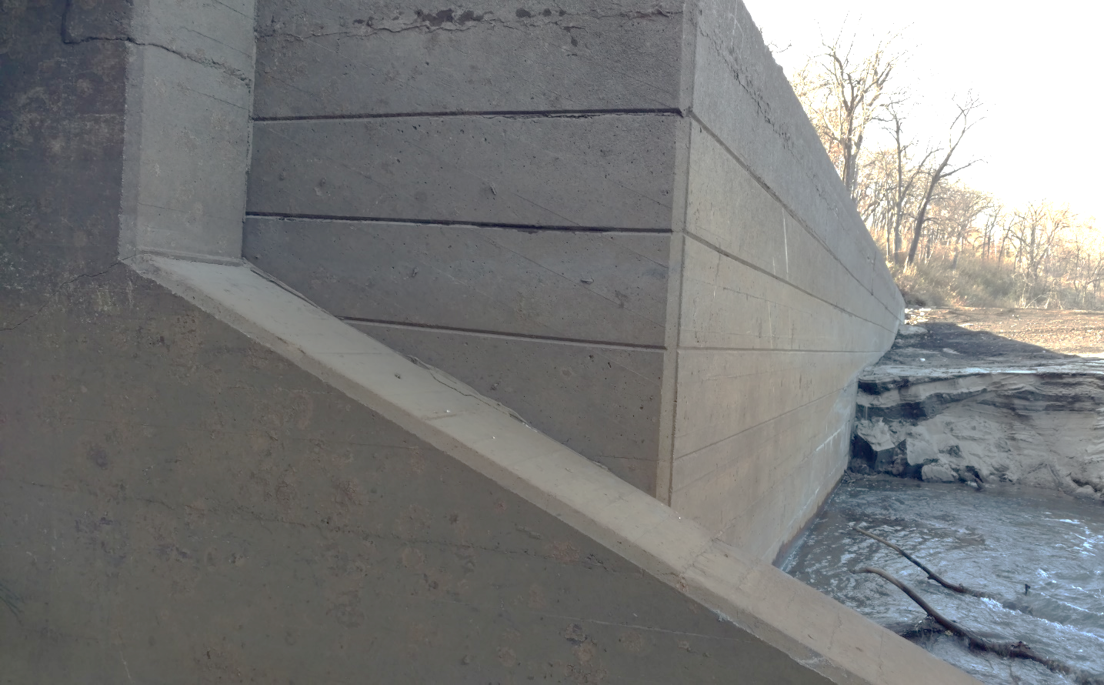
October Dam Inspection
3. Concern – continuous crack through sluiceway’s right wall, possibly due to ice forces pushing sluiceway downstream

Slide 7
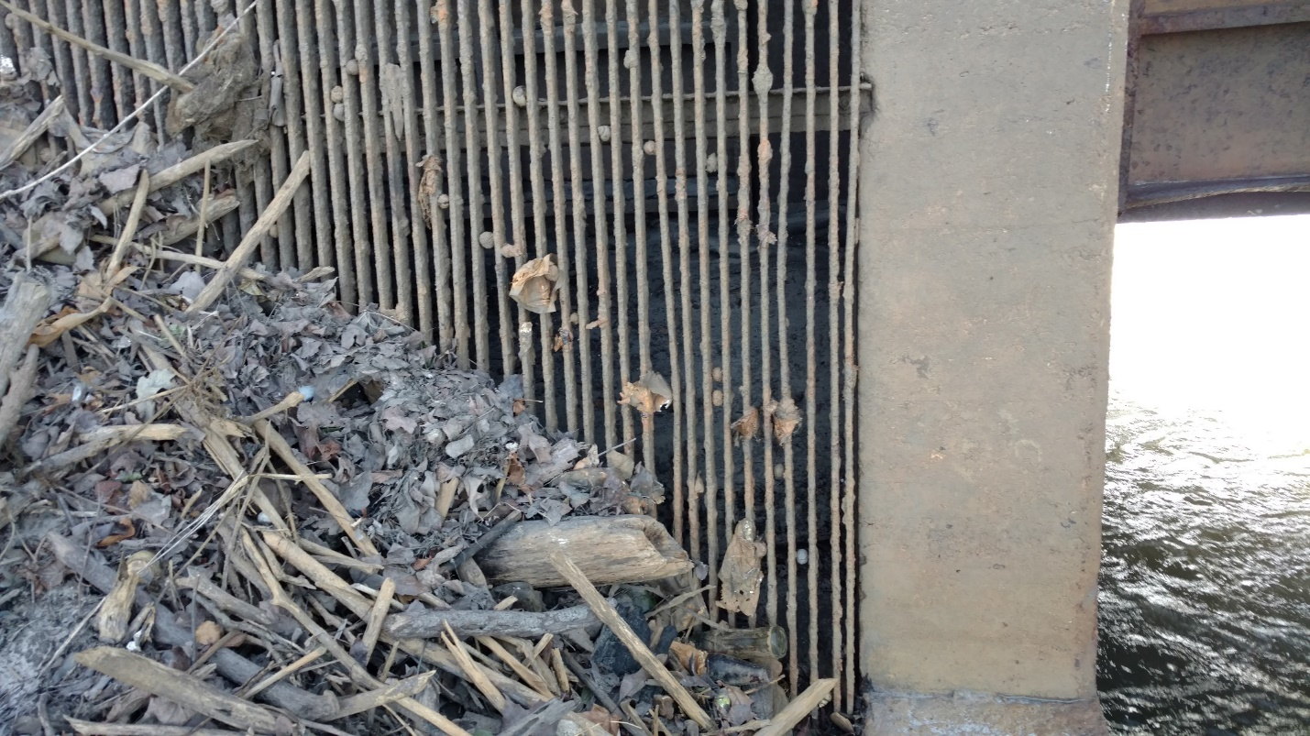
October Dam Inspection
4. Concern – trashrack plugged 50%, possibly to point where full powerhouse flow would result in trashrack buckling

Slide 8
Lessons Learned in 2020
The Kinnickinnic River is subject to floods larger than the sluiceway can handle, and both full lake and full drawdown conditions will face challenges during floods.

Slide 9
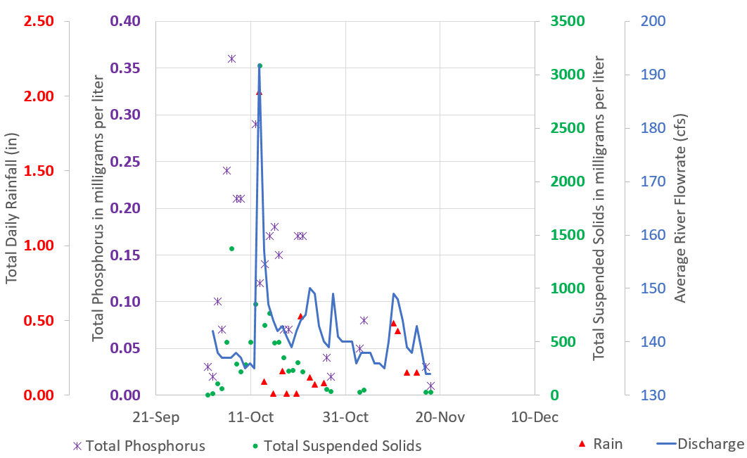
Lessons Learned in 2020
A slow drawdown worked well for limiting sediment transport and turbidity
A rapid refill followed by fast drawdown (“lake bounce”) increases sediment release and turbidity levels

Slide 10
Options for Path Forward
Option 1: Repair the dam, refill Lake Louise in 2021, operate powerhouse until 2023, then initiate dam removal 2024-2026 with restoration by 2027.
Option 2: Keep drawn down with no changes until 2023, then initiate dam removal 2024-2026 with restoration by 2027.
Option 3: Keep drawn down, but fix gate so it opens more (and more easily) and pull turbine, start sediment removal downstream of dam in 2021, surrender FERC license for Powell (2022), and apply under state jurisdiction to remove dam after amending FERC license. Site restoration expected to be complete in 2026.

Slide 11
Options for Path Forward
Option 4: Keep drawn down, but pull turbine/trashrack, and add new flow opening in 2021 (under FERC authority). Sediment removal in 2021 and lakebed shaping in January 2022. Complete dam removal 2024-2026 with restoration by 2027.
Option 5: Keep drawn down, and proceed with dam removal as rapidly as permits/approvals will allow. Sediment removal in 2021 and lakebed shaping in January 2022. Armor Lake Louise channel to lock it in place while dam is removed in 2022-2023. Restoration by 2024.

Slide 12
Wisconsin Department of Natural Resources Consultation
Conference Call on 11/19/20
12/15/20 letter from WDNR recommends keeping the impoundment drawn down until the Powell Falls dam is ultimately removed and suggests these actions:
Utilize frozen substrate this winter to conduct grade stabilization of lakebed and Lake Louise channel
Create a larger opening in the dam to reduce lake bounce potential
Utilize proactive sediment management measures to reduce risk of prolonged periods of high TSS downstream to protect aquatic organisms
At a minimum, the Department expects for any action that is pursued by the FERC and the City of River Falls, active sediment management, potential risk to the resource, and life, health and property, be prioritized.

Slide 13
Trout Unlimited Consultation
Conference Call on 11/19/20
12/15/20 letter from TU prefers Option 5, but in the mean-time their letter suggests these actions:
Modify the powerhouse to help flow control
Seed impoundment immediately and manage invasive species for 3-5 years
Lower sanitary sewer crossings as needed
Implement sediment trapping as soon as possible and clean regularly
Excavate a pilot channel in lakebed (55 foot wide trapezoidal channel)
Add more disposal sites along lake fringe, like along the Glen Park Access road

